Slide 1
CubeSat Mounting Fixture
Critical Design Report
April 30, 2020
Northern Arizona Senior Design Team:
Richard Campos – Project Manager
Jacqueline Fonseca – Website Designer
Zackary Retzlaff – Client Contact
Jacob Belin – Budget Liaison
Notes:
1
Richard

Slide 2
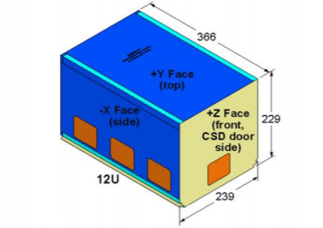
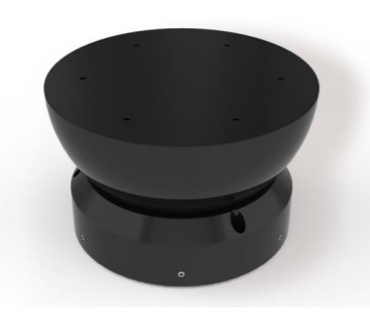
Program Description
The proposed effort will design a mounting fixture for a 12U CubeSat so a frictionless environment can be achieved on an Air Bearing Test Stand.
The design must:
Refocus Center of Gravity*
Limit Tilt Degree
Be Adjustable in Three Axes*
Be Adjustable to Different Payloads

Slide 3
CDR - Agenda
Administration
  Action Item Review
  Action Items Form
  CDR - Entrance/Exit Criteria
Integrated Master Schedule
Mission Requirements
  Requirement Variations
  Requirement Refinement
Concept of Operations
System Level Design
  System Level Design
    Document Tree
    Drawing Tree
  Subsystem Design
    Electrical / Power
    Mechanical
  Subsystem Interface Documents
    Hardware, Electrical, & Test
Analysis
Requirements Verification Matrix (RVM)
Assembly, Integration, & Test (AI&T)
  Test Plan
    Test Documentation / Procedure Tree
  AI&T Functional Testing
  IT Test Flow
  Preliminary Ground Support Equipment
  Test Equipment Capabilities
Recommended Spares List
Risk Assessment & Mitigation Plan
Loaned Equipment Required
Action Item Review
CDR - Exit Criteria
Conclusions

Slide 4
Administration
Meeting Minutes
  Posted on capstone website
Technical Analyses, SRR, PDR, CDR, etc.
  Provided upon request via email
Notes:
The team as a whole performed analysis and conducted the proper documentation that drove the design choices of the CubeSat fixture. These reports can be found on the capstone website that Jackie Fonseca has made for the team.

Slide 5

Action Item Review
ID# | Action | Satisfied
1 | Cost, schedule, and technical risks are identified, and mitigation plans are in place.
2 | Risk management plan is complete and adequate.
3 | Critical technologies have been identified, readiness assessed, and maturation plans developed.
4 | Programming languages and logical architectures, security requirements, and operational and support concepts have been identified.
5 | The program schedule is executable with an acceptable level of technical and cost risk.
6 | System requirements have been synthesized into conceptual architectures.
Notes:
These are all goals pulled from the SRR done earlier in the semester. These are some of the things our team has set out to do and will talk about during the duration of this critical design review. The team has completed more tasks than this but this is just a snippet of what we have completed and I think these are the most important to address since they pertain to this particular meeting and could potentially be new information for our clients. We will go over our design and any changes we have made as well as plans in place for the electrical components of this fixture. We will also go over the schedule and some of the technical risks associated with our design variant.

Slide 6

CDR Entrance Criteria
Entrance Criteria | Satisfied
Completion of the Requirements Review.
Adjudication of the Action Items.
All major design changes are ready to present.
Completion of Integrated Master Schedule.
The System test strategy is documented.
Notes:
We completed the SRR earlier in the semester. I just went over some of the action items we have completed that we will discuss in this meeting. We will go over our design changes in detail as it pertains to the information we are presenting. We also have plans in place to test our fixture and have established a master schedule that will be gone over in detail as well. In order to present our critical design report, our team needed to make sure to complete these criteria.

Slide 7
CDR Exit Criteria
Exit Criteria | Satisfied
GA concurrence with the proposed design.
Capture Action Items and close any items that are a lien against CDR closure.
Deliver all of the required documentation.
Notes:
This will be discussed towards the end of the presentation to see if the clients want to go forward with our design. After we determine this, we will either go forward with the prototype or redesign. This is completely up to our clients if they recommend going forward with our design.

Slide 8
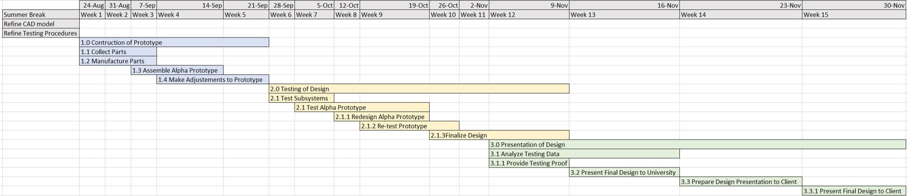
Integrated Master Schedule (IMS)
Notes:
This is a Gannt chart detailing the tasks to be performed during the fall semester of the capstone project. Next semester is broken up in three stages, the first being the manufacturing of the alpha prototype of the fixture, the second consisting of the testinf and any redesign that is would be required, and the last being the evaluation and presentation of our design. Before the semester, the team will make a more thorough SolidWorks model so that we know the components that we will need to either purchase or manufacture in house. This will help to make sure that the team makes effieicenrt use of time when constructing the alpha prototype.

Slide 9
Design Requirements
ID | ER | Target Value | Tolerance | How it is met
1 | Accept CubeSat (Lifts Weight) | 24 kg | 2 kg | Material properties and clamping mechanism
2 | Movability in all Axis | 50 mm | 2.5 mm | Sliding plate
3 | Limit Tilt Degree | 35 deg | 1.75 deg | Fixture can only tilt the limit in each direction
4 | Allow 360 Degree Rotation | 360 deg | - | Moves with air bearing
5 | Limit Weight | 50 kg | 2.5 kg | Using light materials and only minimum counterweight required
6 | Limit Size | 9 m^3 | .045 m^3 | Fixture size will be limited to fit CubeSat
7 | Material Strength | 200 MPa | 10 MPa | Material choice
8 | Lifetime Cycle | 1*10^4 | - | Material properties and durability of parts
Notes:
In the beginning of this semester the team created a specific list of engineering requirements (ER) that the design must accomplish. This ER are the following: accept 12U CubeSat (Lift the weight of it), have movability in all axis, limit tilt degree, allow 360 degree rotation along the center of device in the xy plane, limit weight, limit size, have a durable device, and a long lasting device. Each of these ERs have an associated target and tolerance that can be seen in the table above. The table also includes the way the device will meet each of these ERs.

Slide 10
Requirement Variations since SRR
Ensure design can adjust in z-axis
  Vertical Rails vs. Rigid Plate
  May design for 12U, 6U, and 3U payloads only
Ensure design can adjust to different payload sizes
  Lever clamp can expand/contract to accept tabs at different widths
Electric Motors to Pneumatic Motor
  To make the device non-magnetic, will use pneumatic force to displace counter-weights
Shift focus away material properties
Notes:
Over the course of the semester, the team presented concepts for the subsystems of the mounting fixture. After the individual analysis and the PDR, there were several design changes that occurred. A meeting early in the design process concluded the material properties would not be a major concern. One of the client’s first request was to make the device entirely non-magnetic. Following the individual analysis, it was determined the magnetic flux from step motors was to significant and pneumatic motors were selected for our device. The project request stated the device would be designed for a 12U CubeSat. During the modeling stage, the adjusteable mechanism for the clamping system was integrated into the design so this enables our device to accept different payloads.

Slide 11
Concept of Operations (Customer Needs)
Reliable
Durable
Limit Space
Limit Overall Weight
Non-Magnetic
CubeSat easily installed and removed
Simply and effectively secure CubeSat
Adjustable on all three axis
Compatible with Air Bearing Table
Refocus center of gravity for assembly
Fixture does not fall off test stand
Notes:
One of the first meetings with GA was very constructive as we got to meet in person. From this meeting, the team determined the customers needs and expectations for the design. The device would obviously have to be a rigid mechanism so no NVH issues occur and the fixture can withstand testing conditions and safely secure the CubeSat. Designing for a reliable device must consider the dimensions and assembly weight with a 12U Cubesat. The client mentioned a non-magnetic construction but after an brief description of testing procedures, the team decided it was imperative to have no magnetic components. One of the primary needs for our device is for it to refocus the center of gravity to the center point of the air bearing sphere. This was a major design criteria.

Slide 12
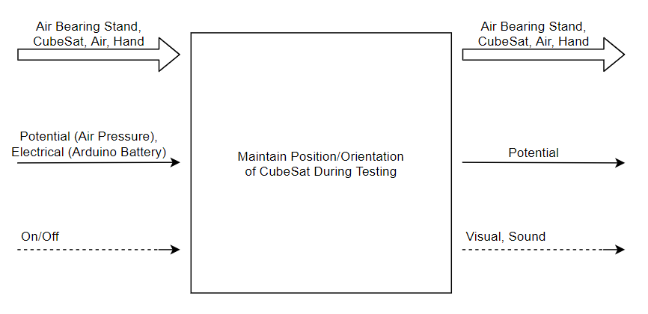
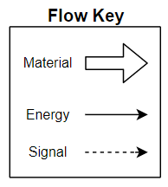
System Level Overview
Black Box Model
Notes:
In order to understand the device better and understand the specific flows that the device will have, the team created a Black Box Model. The Black Box Model can be seen in the image above and describes each of the flows coming in and leaving the device. The material flow in and out are the same, these are the air bearing stand, the 12U CubeSat, air, and a hand. The energy flow in is potential air, with air pressure, and electrical with the Arduino battery. The energy flow leaving the device is potential energy. The signal flow coming in is an on/off switch, and the signal leaving is a visual movement and a sound. All of these flows will come in contact with the fixture design and must be thought about.

Slide 13
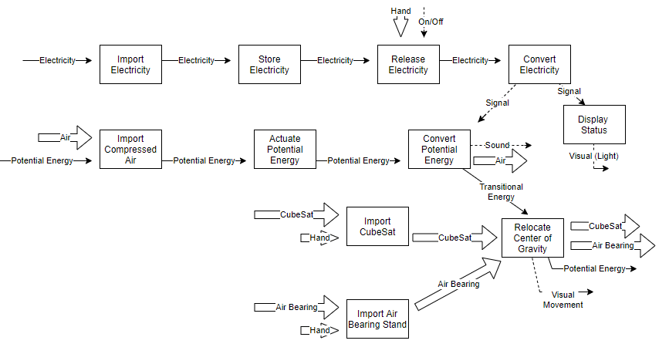
System Level Design:
Document Tree
Notes:
To further develop an understanding of the flows that the device has a function model was created. This functional model takes each of the flow input and outputs in the black box model and shows specifically where they go and what they do inside of the device. Following each flow helps understand how the device is going to function. The entire functional model can be seen above.

Slide 14
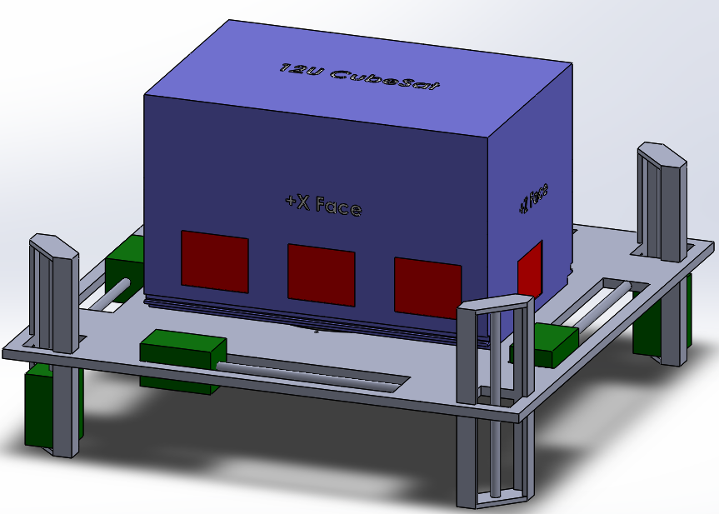
System Level Design:
Drawing Tree
Notes:
After two iterations, the team embodies the mounting fixture into the CAD model on this slide. The device consists of the CubeSat model with the representative keep out zones. These zones were a constant focus in client meetings, so our device entirely avoids obstructing those zones. The major design criteria for the device is to refocus the center of gravity. To do this, the green blocks on the model represent the counter-weight/power screw assembly. This will displace a weight and adjust the center of gravity for the fixture assembly. These counter-weights travel on a rail tapped so the counterweight can move via the screw. There are four counterweights parallel with the fixture platform and adjust the center of gravity in the xy-plane. At each corner is a vertical rail so the center of gravity can be adjusted in the z-axis.

Slide 15
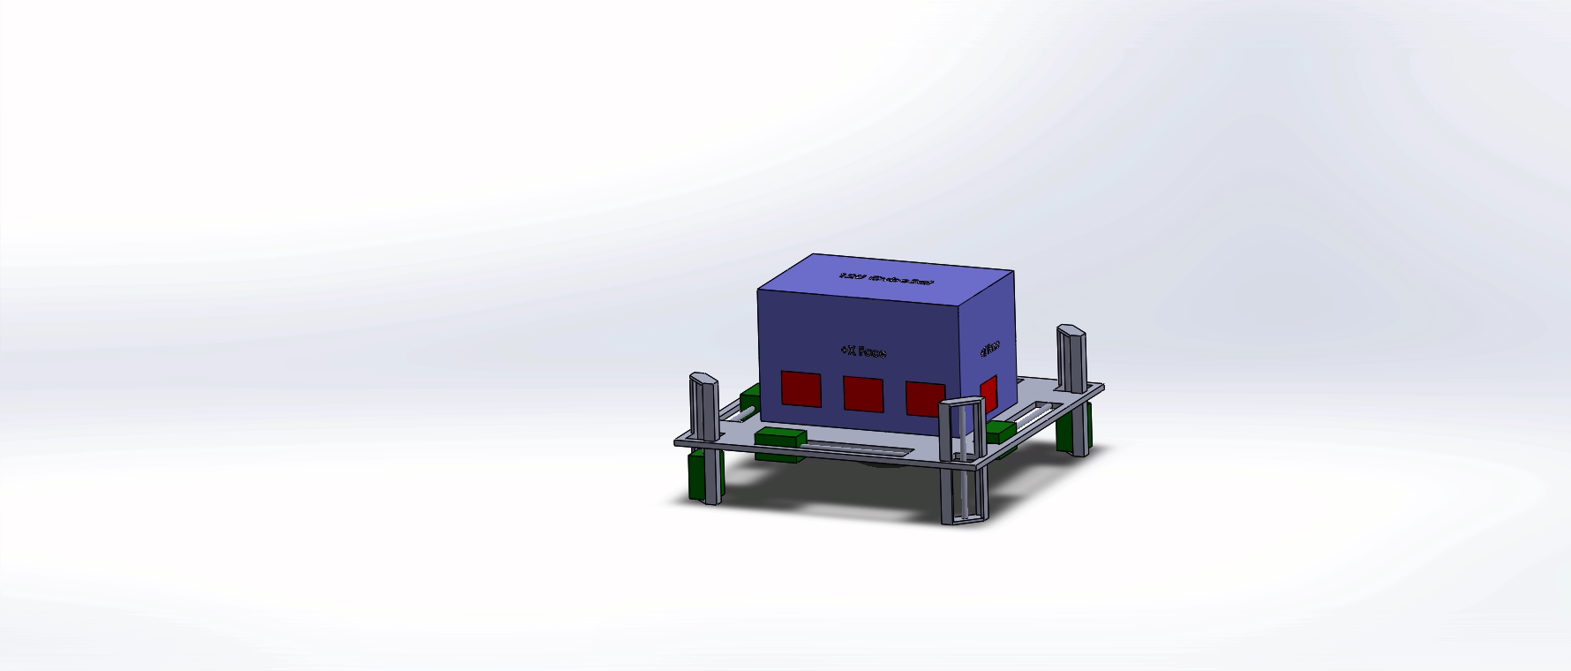
System Level Design:
Drawing Tree
Notes:
This slide shows an animation for the exploded view for CAD drawing. This view shows how the components come together. One key view in this animation is the air bearing sphere under the platform. This sphere is connected to the platform by screws which will have tapped holes on the platform.

Slide 16
System Level Design:
Bill of Materials
Part # | Part Name | Qty | Description | Functions | Material | Dimensions | Cost ($USD)
1 | Pnuematic Tool | 6 | Reverse engineered pnuematic wrench | Displace counter wt | Aluminum | - | 179.94
2 | Tubing | 1 | Piping for working air to pnuematic motor | Direct air to motors | Aluminum | 0.5"x48"x1/16" | 12.98
3 | Compressor | 1 | Pnuematic system | Provide air supply for pnuematic system | - |  | 0
4 | Pipe Fittings | 10 | Pnuematic system | Direct and couple air lines for motors | Brass | 0.5" | 40
5 | Storage Tank | 1 | Pnuematic system | Hold air supply for pnuematic system | Steel | 8"x10"x1/8" | 0
6 | Ctr. Wt. and Bench for Motors | 8' | Stock material for prototyping | Stock material for prototyping | Wood | 1"x4" | 22.45
7 | Fasterners | 1 | Securing components | Securing components | Plastic |  | 6
8 | Fasterners | 6 | Securing components | Securing components | Aluminum |  | 2.76
9 | Pressure Sensors | 4 | Force sensing resistor | Determine CG location | - |  | 44.36
10 | Lubricant | 1 | Petrol based lube | lubricate pnuematic motors |  |  | 4.95
11 | Platform | 5 | Stock sheet metal for fab work | Attach CubeSat to air bearing stand | Aluminum | 6"x18" | 20.1
12 | 3D Material | 4 | Corn based plastic | for 3D printed model | Corn/Plastic |  | 79.4
13 | 12V Batter | 1 | Simple RC battery | Provide energy for Arduino system & valves | Lithium |  | 6.2
Total Cost Estimate ($USD): 419.14
Expenses to Date ($USD): 29.99
Notes:
Using the exploded view and considering the subsystems of the mounting fixture, a tentative bill of materials is provided on this slide. The items selected in this design are “off the shelf” items which are being repurposed. This decisions will keep costs low and provides the client with the flexibility to recreate our design or make decisions to fabricate their mounting fixtures. The stock or bulk material in this list will be used to fabricated unique parts like the platform and counterweight subsystem. A major expense in this design is the pneumatic subsystem. The pneumatic motors, fittings, and piping are expected to be a large portion of the estimated cost.

Slide 17
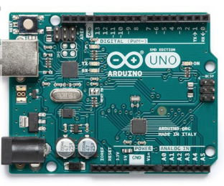
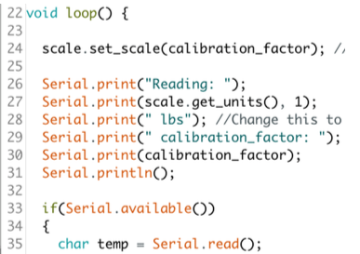
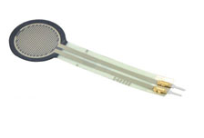
Subsystem Design:
Electrical / Power
Notes:
The plan right now is to draw power from a battery or a computer for the Arduino motherboard. In order to do this, cables will need to be connected from the computer or wires from the battery to the motherboard. The motherboard will also be connected to the pneumatic motors and force sensors. The program will take readings from the force sensors to adequately assess where the center of gravity of the CubeSat/mounting fixture assembly is. Thereafter, it will relay this information to the pneumatic motors to move the CG of the fixture to align with the CG of the CubeSat. With the CubeSat at rest and the counterweights in their initial positions, the CG is directly at the center of the x and y axes. However, the assembly is bottom heavy so the center of the mass in the z direction is more towards the bottom of the fixture when the counterweights are at rest.

Slide 18
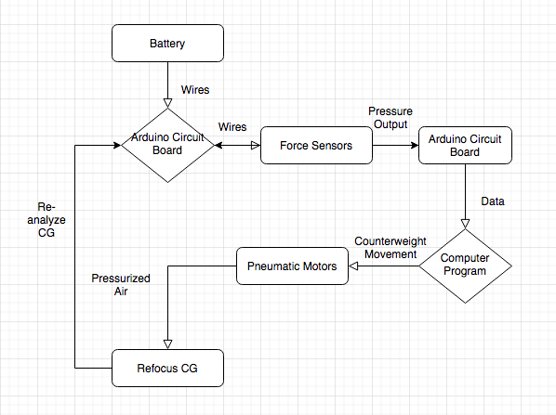
Electrical System Block Diagram
Notes:
This block diagram shows where all of the signals go in the electrical circuit. Each block is an important component of the circuit. In order to show where each of the signals go in the circuit, this block diagram is very important. An electrical schematic will be created during the summer in order to better outline the electrical components of our system.

Slide 19
Electrical Design:
Cabling
Cables will all be connected to the Arduino motherboard
Cable will be connected from motherboard to computer to input and output information
Battery will also be connected to the motherboard
Notes:
The cabling can be easily seen on the block diagram, but this slide basically explains in more detail where all the cables are located. Once again, an electrical schematic is going to be created during the summer in order to better understand where everything goes in the circuit.

Slide 20
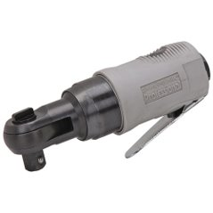
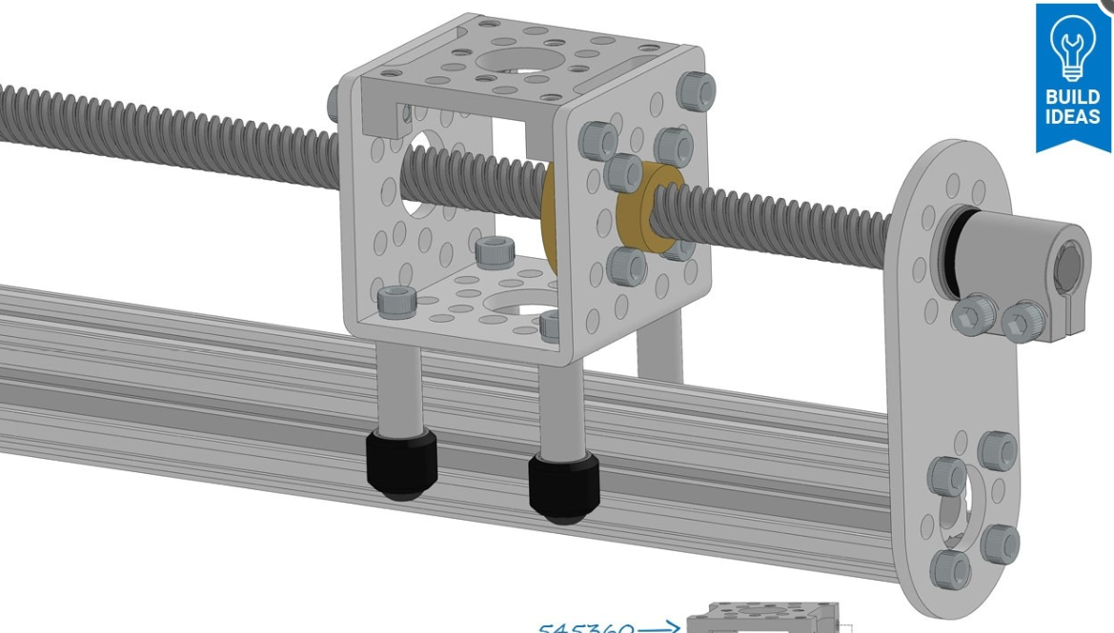
Subsystem Design:
Mechanical/Pneumatic
Current design will modify existing pneumatic motors
Direction of rotation controlled by solenoid valves
Motors will rotate worm screw, which pushes counterweight forward/backward
Notes:
After verifying that the team would be unable to use stepper motors in our design due to the magnetic field constraint given to us by the client, the team decided that the best option moving forward was to utilize pneumatic motors. The current plan is to modify an existing pneumatic tool (in this case a palm wrench seen above) so that it could drive our worm screw mechanism. The direction of rotation will be controlled by solenoid valves which dictate said direction from data input from the Arduino. All of this will drive a worm screw mechanism similar to the one seen above. The cube lke shape in the picture will instead be the counterweights used to change the center of gravity. This component with then move forewards and backwards with the rotation of the power screw.

Slide 21
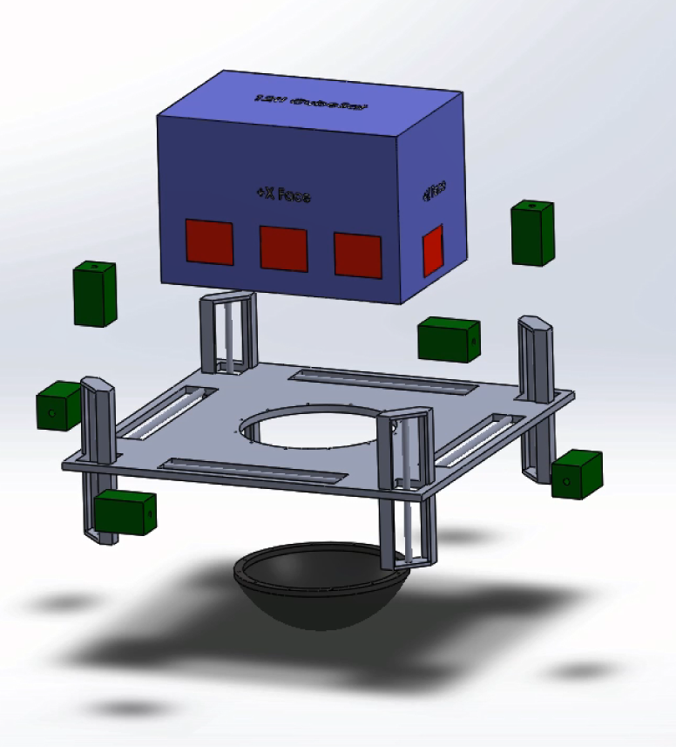
Subsystem Design: Mechanical
Layout of Major Components
1) Device frame
2) Horizontal counterweight mechanisms
3) Vertical counterweight mechanisms
4) Counterweights
5) CubeSat (12U)
5)
4)
3)
2)
1)
Notes:
This is an exploded view of the major mechanical systems in our fixture. It currently consists of four horizontal counterweight mechanisms to adjust the center of gravity in the x and y directions, and four vertical counterweight mechanisms to adjust the center of gravity in the z direction.

Slide 22
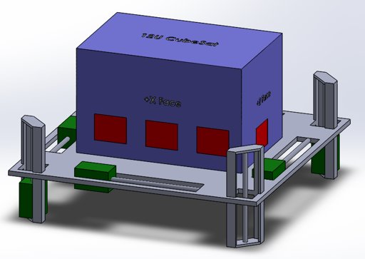
Subsystem Design: Mechanical
Physical Dimensions
Current frame has dimensions of approx. 507 mm x 507 mm
Height w/out CubeSat approx. 207 mm
Notes:
Based on the current SolidWorks model of the CubeSat fixture, the dimensions of our fixture comes out to 507 by 507 by 207 millimeters. Because the redesign phase of most projects usually consist of changing the outward dimensions of the design, these numbers are expected to change by the final deisng, but the team does not anticipate that the change will be extremly drastic.

Slide 23
Quality Functional Diagram (QFD)
Notes:
QFD
The QFD was a key tool to determine the important criteria in our design. The customer needs were rated to how well they correlated to the engineering requirements we imposed on our design. The engineering requirements with the highest scores would reflect the most important design criteria. In our design, the precision of the center of gravity is a driving design criteria. The main focus of the model we have is made to address this. Another high scored criteria is the rotation degree for the fixture. The discussions with the client have shown us the device must be able to rotate 360 degrees, so our device enables that.

Slide 24
Assembly, Integration, & Test (AI&T): Test Plan
Test each sub-system separately
  Pneumatic System
  Counter-Weights / Power Screw System
  Clamping Mechanism / Sliding Rail System
  Arduino / Pressure Sensors
Test entire system
Notes:
The initial test plan to start off the next semester has been created. The first tests that the team will complete are on each of the separate sub-systems of the device. The different sub-systems that will be tested for the device are, the pneumatic system, the counter-weight and power screw system, the clamping mechanism and sliding rail system, and finally the arduino and pressure sensors. After each of the sub-systems are tested and approved then they wil all be combined for a prototype of the entire system and tests will be conducted on that.

Slide 25
Preliminary Ground Support Equipment Assessment
Sub-System Testing​ | Equipment Needed​
Pneumatic System​ | Compressor / Air Tank​ Valve​ Air Tubing​ Pneumatic Torque Motor​
Counter-Weights / Power Screws​ | Power Screw​ Count-Weights​ Flat Plate "Fixture"​ Cube Weighing same as 12U​
Clamping Mechanism​ / Sliding Rail | Clamps​ CubeSat tabs​ Flat Plate Fixture​ Cube weighing same as 12U​
Arduino / Pressure Sensors​ | Arduino​ Pressure Sensors​ Cube weighing same as 12U​
Entire System​ | Same as all other tests​
Notes:
For each the sub-system tests, specific equipment is needed. This equipment list for each of the different tests can be seen in the table above.

Slide 26
AI&T: Test #1
Pneumatic System Test
System would be set up
  Compressor connected to the valve which is connected to the motor, through tubing
Then the system will turn on to assure motors work
Then counter-weights will be attached to test air needed for the torque to move power screws
Different analysis/tests on the air pressure vs torque out-put will be conducted
These tests will also be checked through hand calculations
This tests the ability to power the fixture and is apart of the entire sub-system to relocate the center of gravity
Notes:
The first test that the team will complete is the Pneumatic System Test. To complete first the team must set up the entire system. To set up the air compressor, valve, motor, and tubing will be purchased. The compressor will be attached to the valve which is attached to the motor through the tubing. Then the system will be turned on and the motor will be connected to the counter-weights. After assuring that the system works and the tubing is the correct sizing then different analysis will be tested on the system to determine the most efficient air pressure. These tests will be repeated and checked with hand calculations to figure out what the pressure should be set at. This system is the entire way to power the device. Therefore this test is verifying that the fixture is able to power itself and run.

Slide 27
AI&T: Test #2
Counter-Weights on a Power Screw
The counter-weights will be attached to the power screws
This system will be attached to a weighted fixture
The fixture will be set at different angles and the counter-weights moved to assure that the fixture will balance
This counter-weight locations will be marked and checked by hand calculations
This tests verifies the ability to relocate the center of gravity of the entire system.
Notes:
The second test that will be completed is the Counter-Weight and Power Screw System Test. To begin the counter-weights and power screws must be bought and attached together. Then this will be attached to the base of the fixture. Then a model of a CubeSat will be constructed. This model will be the same size and weight as a 12U CubeSat and will have weights internally inside that can be adjusted in order to account for different payloads. Then the CubeSat model will be placed onto the fixture and will be manually put at different angles. Then adjusting the counter-weights the correct locations will be marked and checked by hand calculations to assure that the counterweights are leveled. Another test for the counter-weights will be to test different weight options and see which one is the best and most efficient for the device. These tests will verify the devices ability to relocate the center of gravity of the entire system.

Slide 28
AI&T: Test #3
Clamping Mechanism / Sliding Rail
The clamps and CubeSat tabs will be made by 3D printing
The sliding rail will be constructed
The sliding rail and clamps will be attached to a fixture
Then the tabs will be attached to a cube that weighs the same as a 12U CubeSat
Then the clamps will attach to the tabs and will assure stability by moving the device in different angles
This test validates the requirement to accept and secure a CubeSat.
Notes:
The third test that will be conducted is on the Clamping Mechanism System. First the clamps and CubeSat tabs will be constructed, and so will the sliding rail. Then the sliding rail and clamps will be attached to the fixture, and the tabs attached to the 12U CubeSat model previously constructed in the test prior. Then the tabs will be connected to the clamps and the fixture set at different angles to assure that the CubeSat will not fall off of the testing fixture. This test verifys the customer need to accept and securely attach a CubeSat.

Slide 29
AI&T: Test #4
Arduino / Pressure Sensors
The Arduino and pressure sensors will be purchased
The pressure sensors will be set up on a fixture
Then a certain amount of weight will be placed on the sensors at different angles
Using hand calculations the accuracy of the sensors will be checked
Then the Arduino will be connected to the pneumatic system to test the ability for the systems to communicate
This test verifies the fixtures ability to locate the center of gravity.
Notes:
The fourth test that will be conducted is the Arduino and Pressure Sensor System Test. For this test the Arduino and pressure sensors will be purchased. The pressure sensors will be placed on the fixture and a weight placed on top. Then the fixture will be set at different angles and the pressure readings will be monitored to assure that the pressure sensors are accurate. Then the Arduino will be programmed and connected to the pneumatic system to assure that the two systems can communicate with each other. These tests verify the devices ability to locate the center of gravity, and run the system.

Slide 30
AI&T: Test #5
Entire System
The entire fixture will be set up connecting all sub-systems
Then a model of a 12U CubeSat will be attached to the fixture
Then setting the fixture at different angles the device will be turned on
The final location of the counter-weights will be marked and checked with hand calculations
This test verifies the ability of the entire device to work.
Notes:
The final test that will be conducted is on the entire system. First, the device will be built connecting all of the sub-systems tested prior. Then the model of the 12U CubeSat will be attached to the fixture. Then the fixture will be set at different angles and the CubeSat set with different weight configurations and the device will be turned on. Each of the sub-systems will work together to move the counter-weights along the power screw. This locations of the counter-weights will be marked and checked with hand calculations. This entire system test is completed on a prototype of the device to learn more about it. This test is just the first test of the entire system and more tests will be created to assure that the final device is working appropriately and accurately.

Slide 31
Risk Assessment & Mitigation Plan
FMEA (Failure Mode and Effects Analysis) performed on subsystem level
Risk analysis performed and graphed
Data to be used to prepare preventive maintainence procedure during testing
Qualitative and empirical data from prototype to be used to modify risk assessment summary
Notes:
Because our design is going to be used on a fairly regular basis in an experimental setting, the team performed an analysis on the likelyhood of failure for the different subsystems. This data will then be used to look at how to minimize the likelihood of that subsystem failing and to guide us on laying put a procedure on how to either repair or replace components which cause said failure.

Slide 32
Summary Risk Report
ID | Risk Title | Current Risk Status (L, C)
1 | Lead screw thread stripping | 1,5
2 | Pneumatic tubing comes undone | 1,4
3 | Wiring disconnects | 1,3
4 | Tether becomes tangled | 2,5
5 | Securement tabs loosen/fail | 2,5
6 | Pneumatic fittings wear down | 1,4
7 | Rotation of motor internally impeded | 1,4
8 | Counterweight fitting fails | 2,4
9 | Device powered on during operation | 3,1
32-Richard
Notes:
This is an itemized list on different failure modes that the team identified for the current design of the CubeSat fixture. The team used previuous empirical knowledge of similar methods used for past projects to determine the likelihood of failure (L) for the different subsystems in our fixture. We then determined the degree of damage ( C ) that would occur if each failure were to occur. Both the likelihood and consequence of failure were given values ranging from 1 to five and then graphed, which can be seen on the next slide.

Slide 33
Risk Assessment Summary
Current Risk State
9
8
4
5
3
2
6
7
1
33 - Richard
Notes:
The failure modes were graphed to help visualize for the team which failure modes had the most priority in regards to correction, mitigtion procedure and potential redesign. The green section indicates the failure modes that have a low risk state associated with them, the yellow a medium risk state and the red a high risk state. Thankfully, the team has no yet identified any failure modes that are at a high risk state, but this could change when we go through the experience of actually working with the CubeSat fixture during its building and testing. With the evaluation of the risks that can occur during the function of the CubeSat fixture, the team will move forward with a preventative maintenance plan and a procedure to repair or replace the components in the CubeSat fixture.

Slide 34
Action Item Review
Action Item Capture & Documentation
Located in the SRR
Meeting minutes and schedule well documented by the team
Notes:
The action items that have been completed over the duration of the project are highlighted in the SRR and documented in the schedule created by our project manager. The SRR is what the team has focused on for the duration of this project in terms of action items. These action items have been discussed with our clients at General Atomics as well as our professor. In order to create an effective project, this SRR helped guide the team in the right direction.

Slide 35
PDR/CDR Exit Criteria
Exit Criteria | Satisfied
GA concurrence with the proposed design.
Capture Action Items and close any items that are a lien against CDR closure.
Deliver all of the required documentation.
Notes:
This is open to GA's questions and/or concerns. This is the step where GA either recommends we go forward with our initial prototype or have to redesign. In our presentation with GA, they recommended we go forward with our design concept with a minor change to make sure the z-direction center of gravity is accounted for. This is a minor change the team will make before any testing is done over the summer.

Slide 36
Conclusions
Understand subsystems for mounting fixture to function.
Shown how subsystems integrate and resulting form of the device
Summer
  Benchmark and test subsystems
Fall
  Build prototype
  Formulate procedures and manufacturing
Notes:
The semester was organized so the design team can address the iterative process of engineering design. The customer needs and engineering requirements established early in the process are still criteria driving the design of this project. The center of gravity and CubeSat securing mechanisms have shown to be a highlight of the device. Through weekly staff and biweekly client meetings, the team was able to capture the design concepts for the mounting fixture and have high hopes for the summer and fall terms. The summer term was determined to be used to create beta prototypes for the major subsystems and benchmark them. This would give the team an understanding of feasibility of the design. The fall term will be used to build the alpha prototype and create fully function prototype for the client. It is also expected the team will deliver a handbook for operating and manufacturing procedures.

Slide 37
Appendix

Slide 38
Meeting Minutes
To be completed post review.

Slide 39
Backup Supporting Content

